Slide 1
Advanced Databases Lecture 5: Indexes and Query Optimisation
Dr. Pierpaolo Dondio,
DTMS-IKM

Slide 2
Query optimisation
Early days, relational dB models criticised for poor query speed
Major research conducted on efficient query algorithms
Most medium complexity+ queries can be executed in many different ways
Purpose of Query Optimisation is to find the best way

Slide 3
Query optimisation
With declarative languages such as SQL, the user specifies what data is required
E.g. SELECT name FROM Staff WHERE rating =7;
rather than how it is to be retrieved.
RA = relational algebra
E.g. RA select RA project
Π_{name}(σ _{rating = 7} (Staff) )
This relieves user of knowing what constitutes good execution strategy.
It also gives DBMS more control over system performance.
(It can choose best strategy..)

Slide 4
Optimization by Indexes and Partitioning

Slide 5
Choose Indexes
When choosing indexes, trying to determine whether adding indexes will improve the performance of the system
General rule is that all primary and foreign keys are indexed
Queries should be analysed to see what columns access data
Frequently used columns should be indexed

Slide 6
Choose Indexes
But….
Have to balance overhead involved in maintenance and use of secondary indexes versus performance improvement gained when retrieving data.
This overhead includes:
adding an index record whenever tuple is inserted;
updating secondary index when corresponding tuple (row) value updated;
increase in disk space needed to store indexes;
possible performance degradation during query optimization to consider all indexes.

Slide 7
Choose indexes for each relation – Guidelines for choosing ‘wish list’
Don’t index small relations – why?
Index Primary Key of a table
Some dBs automatically index primary keys (Oracle does)
Add secondary index to a Foreign Key if it’s frequently accessed
Some dBs automatically index foreign keys (Oracle does)
Add secondary index to any column heavily used as a secondary key.

Slide 8
Choose indexes – Guidelines for choosing ‘wish-list’ (continued)
5. Add secondary index on attributes involved in: selection or join criteria;
ORDER BY; GROUP BY;
and other operations involving sorting (such as UNION or DISTINCT).
Add secondary index on attributes involved in built-in functions.
e.g. Select branchno, AVG (salary)
from Staff
Group by branchNo
Previous guideline suggests index on branch no because its in group by. If you also have index on salary, might be able to get the whole answer from the index alone (index only plan)

Slide 9
Choose indexes – Guidelines for choosing ‘wish-list’ (continued)
6. Add secondary index on attributes that could result in an index-only plan.
See point 6 example – don’t have to access original data at all!
7. Avoid indexing an attribute or relation that is frequently updated. Why?
8. Avoid indexing an attribute if the query will retrieve a significant (e.g. 25%) proportion of the relation. (might be faster just to search the whole relation)
9. Avoid indexing attributes that consist of long character strings.

Slide 10
Consider the introduction of controlled redundancy
A fully normalised system does not necessarily provide maximum processing efficiency. In this situation introducing redundancy in a controlled manner by relaxing the normalisation rules will improve the performance of the system.
Denormalisation

Slide 11
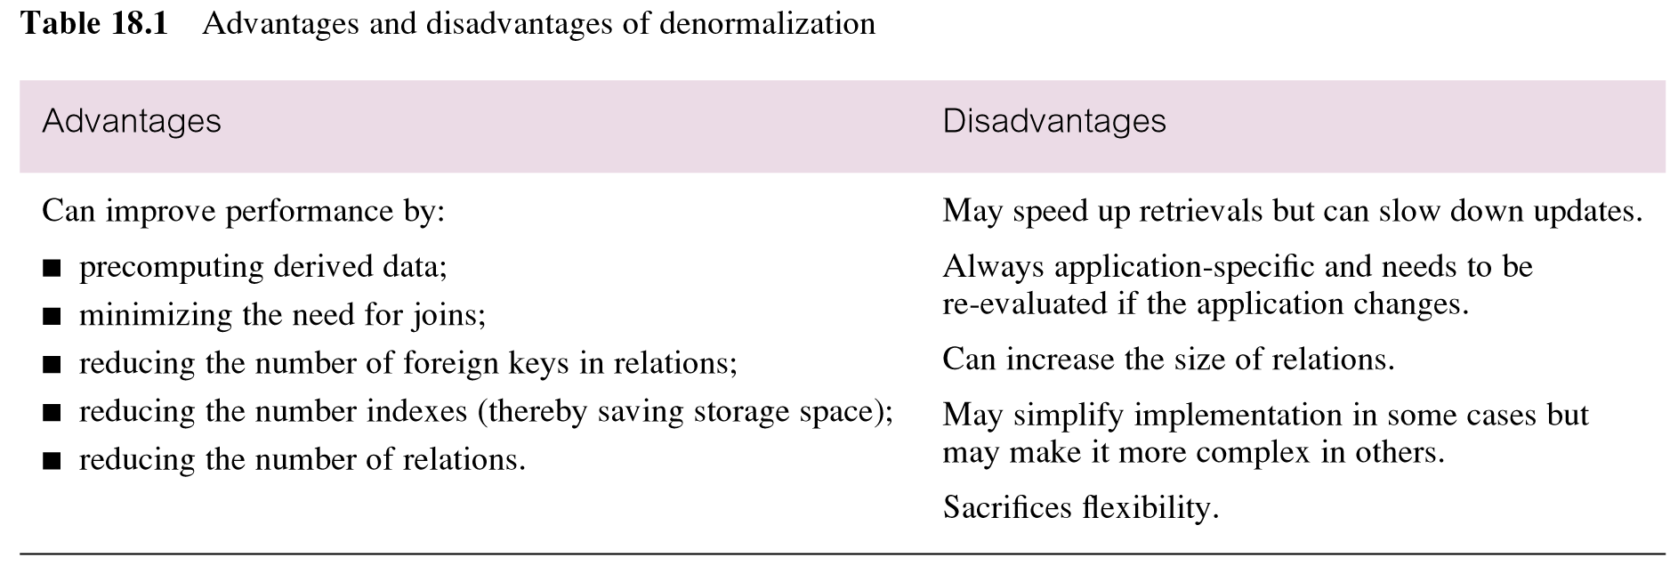
Advantages and disadvantages of denormalization
There are pros and cons..
-
+

Slide 12
Partitioning
Rather than combining relations together, alternative approach is to decompose them into a number of smaller and more manageable partitions
Two main types of partitioning: horizontal and vertical.
Very important technique for performance tuning
Divide and Conquer
How do I decide how to split the table?

Slide 13
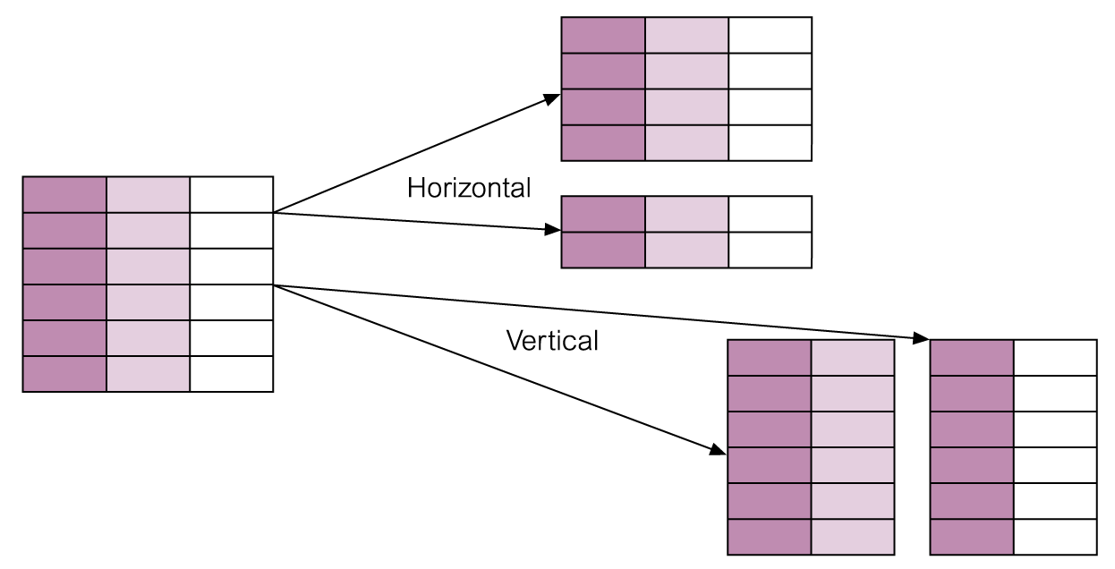
Partitioning relations
Handy if there’s a natural split e.g.
Customers in Dublin in one table, other customers on a 2nd table
Vertical
Maybe some columns aren’t used much

Slide 14
Partitioning: why?
1. Smaller and more manageable pieces of data (Partitions ) 2. Reduced recovery time 3. Failure impact is less 4. Faster access of data 5. Partitions work independent of the other partitions. 6. Very easy to use

Slide 15
Partitioning relations
Partitioning support provided in all leading databases. E.g. In Oracle:
Create table sales (sales_date DATE, custmer int, ..etc)
partition by range(sales_date)
(partition d1 values less than (10) tablespace* sales1,
partition d2 values less than (20) tablespace sales2,
partition d3 values less than (maxvalue) tablespace sales3);
* A tablespace is a logical storage unit; way of organising dB storage

Slide 16
Query Optimisation

Slide 17
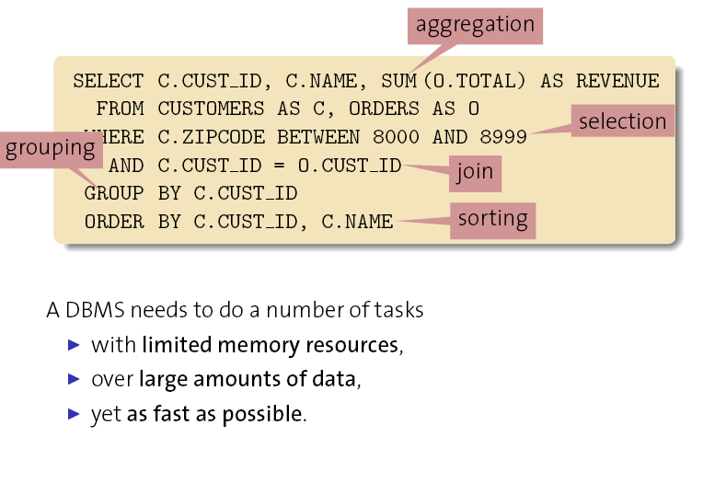
Query Optimisation

Slide 18
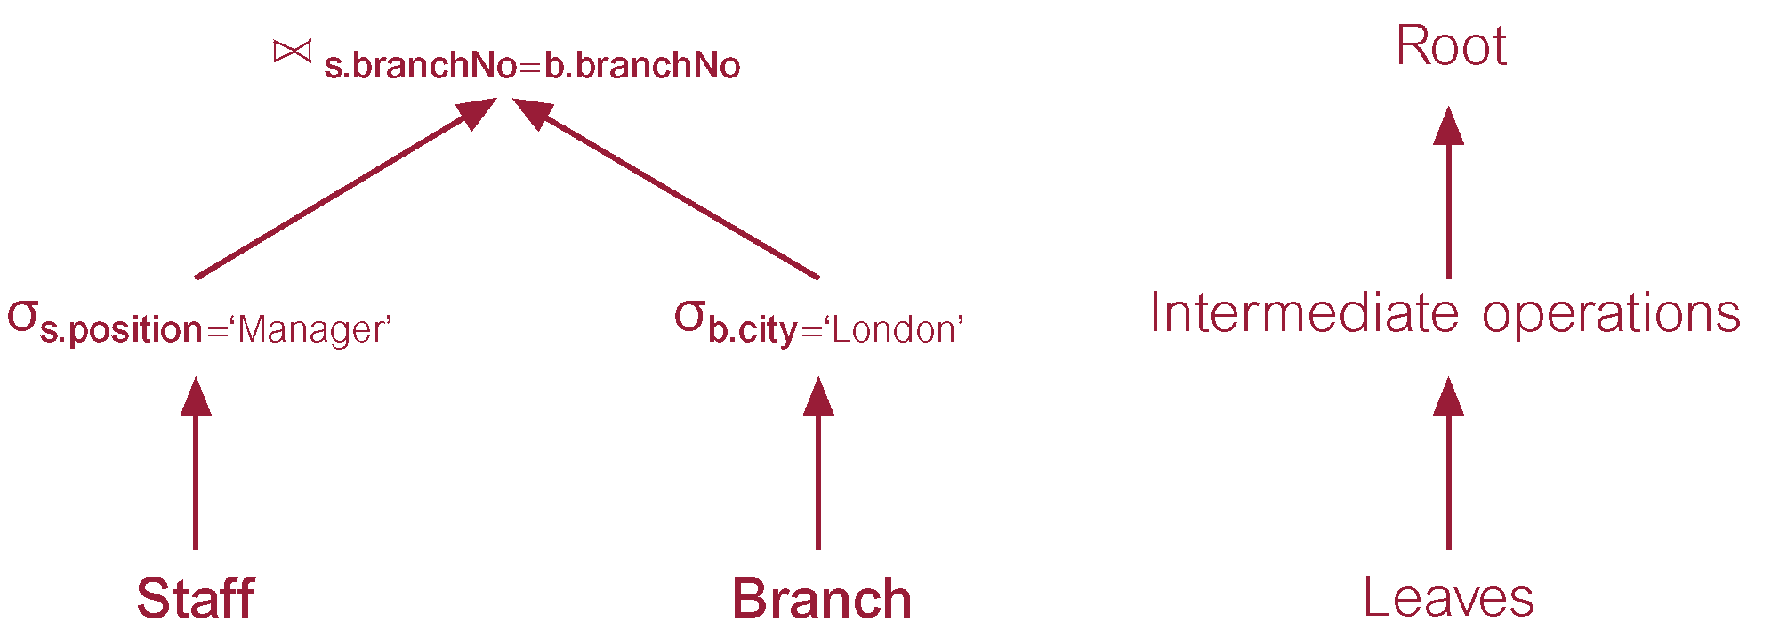
Query trees
For each query, DMBS typically creates an internal structure of the query called a query tree

Slide 19
Query trees
The previous query tree illustrates the query:
Find all Managers who work at a London branch.
Two tables: staff and branch
SELECT * FROM Staff s, Branch b
WHERE s.branchNo = b.branchNo AND
(s.position = ‘Manager’ AND b.city = ‘London’);

Slide 20
Query trees
Leaf node created for each base relation.
Non-leaf node created for each intermediate relation produced by RA operation.
Root of tree represents query result.
Sequence is directed from leaves to root (i.e. bottom to top)

Slide 21
Query optimisation
Activity of choosing an efficient execution strategy for processing query.
There are many equivalent transformations of same high-level query, aim of QO is to choose one that minimizes resource usage.
Generally, reduce total execution time of query and response time
Problem computationally intractable with large number of relations, so strategy adopted is reduced to finding near optimum solution

Slide 22
Example of need for query optimisation
Find all Managers who work at a London branch.
Assumptions for calculations
1000 tuples in Staff; 50 tuples in Branch;
50 Managers; 5 London branches;
no indexes or sort keys;
Every read or writing a row to a result set = 1 disk access
Manager, clerk etc.
Staff (1000)
Branch (50)
Name
Branch_no
Position
…
Branch_no
Address
City
…

Slide 23
Example of need for query optimisation..
SELECT * FROM Staff s, Branch b
WHERE s.branchNo = b.branchNo
AND (s.position = ‘Manager’
AND b.city = ‘London’);
Different things going on in this query*:
Selecting from the staff table (on position)
Selecting from branch table (on city)
Joining the tables (on branch)
*it’s fundamental to understand what these steps are

Slide 24
Different execution strategies
Staff (1000)
Branch (50)
Name
Branch_no
Position = “manager”
…
Branch_no
Address
City = “london”
…
(1) Combine/Merge the two tables into a big pool and then search it on for position (= manager) and city = London)
OR
(2) Join the two tables on branch_no, then search the results of the join (for managers and london branches)
OR
(3) Search each table first (e.g. Search staff for managers, branch for London branches.. Then join on branch
Calculate the cost for each option

Slide 25
Example: First strategy calculations(1)
Combine the two table (staff and branch) – then do the selection criteria i.e. search through all the tuples created by the combination using the selection criteria
Combine the two tables (staff and branch) = combine every row of staff with every row from branch (called Cartesian Product):
Staff = 1000 tuples = 1000 reads Branch = 50 tuples = 50 read
Combine the two tables cartesian product = 1000*50 disk accesses
(2) Search through the result set from (1) on the search criteria : 1000*50 reads
Total = (1000 + 50) + (1000*50) + (1000*50) = 101 050 operations

Slide 26
Second strategy calculations(2)
Join staff and branch on the branch number first – then search through the result on the remaining criteria
(1) Join staff and branch on the branch number = 1000 + 50 disk accesses
(2) Results of join = 1000 tuples = 1000 disk access (because every staff member is in one branch)
(3) Search (select) the results on the search critieria (managers and london) = 1000 disk accesses
Total = (1000 + 50) + 1000 + 1000 = 3050 operations

Slide 27
Third strategy calculations(3)
Read the staff table first (for the managers) .Then read the branch table for the London. Then join the two results on the branch number
Read the staff table to find manager tuples:
1000 tuples read resulting in 50 managers = 1000 reads + 50 results = (1000+ 50) disk accesses
(2) Read the branch table to find the London tuples = 50 tuples read of which 5 are London i.e. 5 results
= (50 + 5) disk accesses
(3) Join the results from (1) and (2) on branch number = joining results of size 50 and 5 respectively = (50 + 5) disk accesses
Total = (1000 + 50) + 55 + 55 = 1160 disk accesses

Slide 28
Comparison
Cost (in disk accesses) are:
(1) (1000 + 50) + 2*(1000 * 50) = 101 050
(2) 2*1000 + (1000 + 50) = 3050
(3) 1000 + 2*50 + 5 + (50 + 5) = 1160
Cartesian (Merge) product and join operations are much more expensive than selection
The third option significantly reduces size of relations being joined together (by 87:1)
This was for tables of 1000 and 50 tuples. If the staff had 10000 and branches had 500, becomes 870:1

Slide 29
Heuristics
“Better to do a select on a relation (table) before using the relation in a join” ( ...as shown?)
These types of “rules of thumb” are called heuristics
dBs (including Oracle) use heurstics for static and/or dynamic query optimisation
E.g of other heuristics
.
Perform projection as early as possible to reduce number of columns
Perform most restrictive joins and selects first (smallest results size) before other operations

Slide 30
Two ways of optimising: Dynamic versus Static
Dynamic
Uses up to date
info e.g. Table sizes→ optimal strategy
But runtime performance on reanalysing query each time
Static
Runtime overhead removed
Complex big queries given many resources to find best strategy..
But (dB stats) might be out of date as using stats from time query was first

Slide 31
Database statistics
Success of Dynamic query optimisation depends on amount and currency of statistical information DBMS holds.
Keeping statistics current can be problematic.
If statistics updated every time tuple is changed, impacts performance.
DBMS can update statistics on a periodic basis, for example nightly, or whenever the system is idle.

Slide 32
Updating Statistics
Here are typical statistics kept
For a relation
Number of tuples, number of tuples per block, number of blocks
For an attribute
Number of distinct values, min, mix,
Selection cardinality – avg num of records satisfying an equality condition
For an index
Number of levels, number of leaf blocks

Slide 33
Selection Operation Implementation
E.g σ _{s.position = ‘Manager’}
May be simple or composite.
If there is no index on the attribute(s), the whole table must be scanned
If there is an index which matches the attribute(s), use it to retrieve the matching tuples
If the records are stored in attribute order, access will be far more efficient.

Slide 34
Join Operation Implementation
SELECT * FROM Managers M, Staff S where M.sid = S.id
The main strategies for implementing the join are:
Block Nested Loop Join.
Indexed Nested Loop Join.
Sort-Merge Join.

Slide 35


Join Operation Implementation – another real world example
At a sale of work, you can buy 100 books. The deal is to take all or none. You take all.
Now, you have to find the books that you already have at home. How would you go about it? Probably, you'd do a merge join:
first, you sort your own books by the primary key (author, title),
then you sort the 100 books by their primary key (author, title).
Now, you start at the top of both piles.
If the value of the left piles primary key is higher, then you take a book from the right pile and vice versa. When both values are equal, then you have found a duplicate.

Slide 36
Simple & block Nested Loop Join
The simplest join algorithm is nested loop that joins two relations together a tuple (row) at a time.
For each tuple in the outer relation M
Scan the entire inner relation S
if match found, add to result
As the basic unit of reading/writing is a disk block, a better approach would be
For each block of M
For each block of S
Check each row of M with each row of S as above

Slide 37
Indexed Nested Loop Join
If there is an index (or hash function) on the join attributes of the inner relation, we can use index lookup.
For each tuple in M
Scan index for matching tuples of S
Use index to access the tuple in S

Slide 38
Sort-Merge Join
The most efficient join is when both relations are sorted on the join attributes, then ‘merge’ by scanning through both looking for matching values
This only works if the join is on equality
(e.g. where M.i_id = S.j_id)
Sort M on join attribute I
Sort S on join attribute j
Scan files concurrently, matching records with same join attribute

Slide 39
Projection Operation Implementation
i.e. selecting specific columns
E.g. SELECT sid, bid FROM Reservations
To implement projection need to:
(1) Remove attributes that are not required
This is straightforward
If an index contains all the wanted attributes in its search key, use the index rather than the base table

Slide 40
Materialisation versus pipelining
When executing a query, the intermediate results are stored/written temporarily to disk
This is called materialisation
(i.e. o/p of one operations stored in temporary relation for processing by the next operation

Slide 41
Pipelining for query optimisation
An alternative approach to materialisation is pipelining
The results from one operation are “pipelined “ to next without writing a temporary relation
i.e. individual tuples (rows) are passed onto the next operation as they appear
This saves on the cost of creating temporary relations and reading results back again

Slide 42
Pipelining for query optimisation
Example: query
Select from Staff where position = ‘manager’ and salary > 2000
Index is on the salary attribute
Steps in materalisation (non pipelined approach)
Select salary > 2000 – this results is stored in a temporary relation
Then
Select position = ‘manager’
Same Example but using pipelining:
No temporary relation is used
The 2nd selection (position = ‘manager’) is applied to individual tuples from select(1) as they are pipelined through from the first select.
i.e. a stream of tuples are produced as i/p and o/p of each operation

Slide 43
Pipelining for query optimisation
The steam of i/ps might not be possible
Might need the whole result of an operation (e.g.in order to feed a “sort” operation.. Need the whole lot before sorting)
But still
Many opportunities for pipelining and important part of optimising queries

Slide 44
Query Optimization in Oracle
Oracle supports two approaches to query optimization: rule-based and cost-based.
Rule-based – static
15 static rules, ranked in order of efficiency.
Score assigned to each execution strategy using these rankings and strategy with best (lowest) score selected.
Cost based – dynamic – uses dB statistics – i.e. optimised each time the query is run

Slide 45
How rule based optimiser works
Rule based optimisation: the DBMS uses a set of rules to determine how to execute the query
Oracle ‘s rule based optimiser has 15 rules for how to access data
The rules are ranked in order of efficiency
The optimiser goes through each.
Use Rule number 1, If that not possible go to next rule... Etc
All done automatically in the background by the rule optimiser

Slide 46
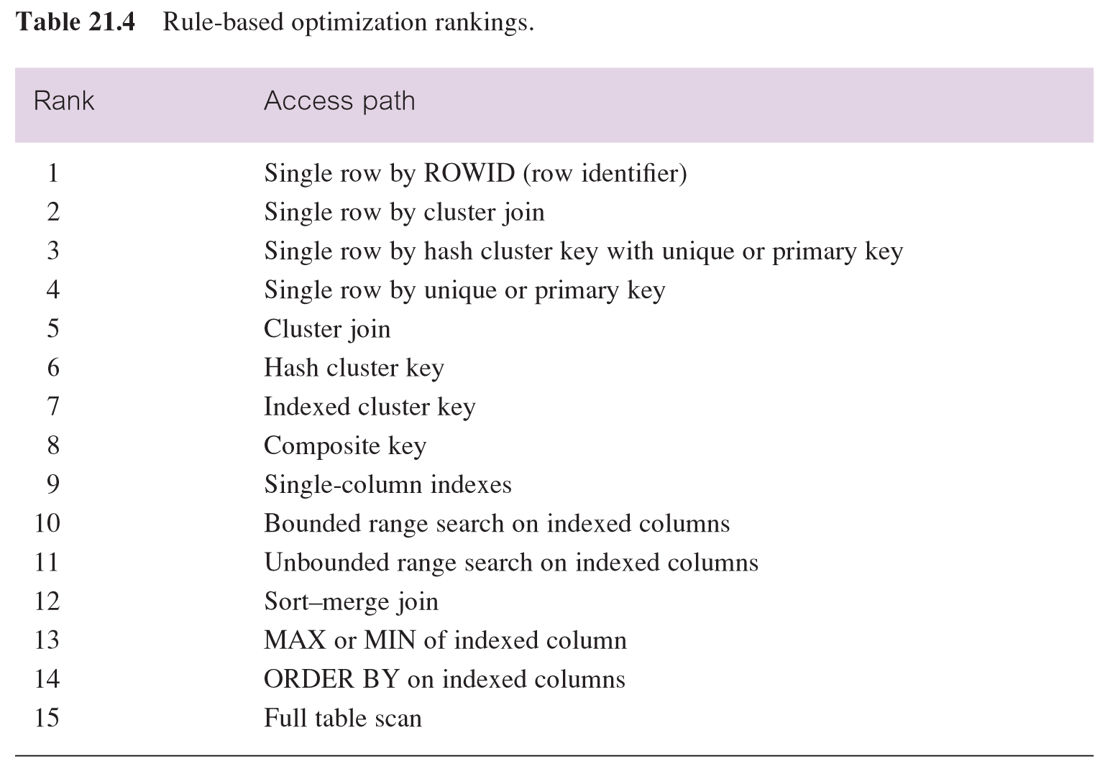
THE 15 RULES
Best way to access
Worst way to access (whole
Table)

Slide 47
Rule / cost – which is better?
Rules can be problematic. The rule-based optimizer's greatest shortcoming is its failure to use the best index.
e.g. An employee table holds details of employees. Index on gender column. (MALE/FEMALE values)
SELECT * FROM emp WHERE gender='FEMALE';
If the above query returned approximately 50% of the rows, then using an index would actually slow things down. It would be faster to read the entire table and throw away all rows that have MALE values
Same with small tables that are indexed… can be faster to access whole table….
In Oracle, queries executed based on cost-based optimization unless switched off. Otherwise, rule based.

Slide 48
Cost based Query optimisation in Oracle
Oracle introduced cost-based optimizer in Oracle 7
User can select whether minimal resource usage is based on throughput or based on response time, by setting the OPTIMIZER_MODE initialization parameter.
Cost-based optimizer also takes into consideration hints that the user may provide
Oracle implements hints by using specially crafted comments in the query that begin with a + symbol, thus not influencing SQL compatibility

Slide 49
Cost based Query optimisation in Oracle
The “costs” of a query rely on up to date statistics
Here are typical statistics kept
For a relation
Number of tuples, number of tuples per block, number of blocks
For an attribute
Number of distinct values, min, mix,
Selection cardinality – avg num of records satisfying an equality condition
For an index
Number of levels, number of leaf blocks

Slide 50
Explain Plan in Oracle
The EXPLAIN PLAN statement in Oracle allows you to submit a SQL statement to Oracle and have the database prepare the execution plan for the statement without actually executing it.
Allows the execution plan chosen by the query optimser to be viewed
Useful when “Why is my query slow?”
Output from Explain Plan is written to a table in the database (default is PLAN_TABLE)
To view the execution steps of the query, select the data from the PLAN_TABLE (or whatever table you used)

Slide 51
Practical Tips

Slide 52
1. Optimizing Single-Table Queries
To improve the performance of a query that selects rows of a table based on a specific column value, create an index on that column. For example, the following query performs better if the NAME column of the EMP table has an index.
SELECT * FROM EMP WHERE NAME = 'Smith'

Slide 53
Index on Join
Outer
Inner left
Inner Right
Where is it better to put an index?
Why?

Slide 54
2. Create an Index on the Join Column(s) of the Inner Table
SELECT e.SS#, e.NAME, d.BUDGET FROM EMP e, DEPT d WHERE e.WORKS_IN = DEPT.DEPT# AND e.JOB_TITLE = 'Manager';
In the following example, the inner table of the join query is DEPT and the join column of DEPT is DEPT#.
An index on DEPT.DEPT# improves the performance of the query. In this example, since DEPT# is the primary key of DEPT, an index is implicitly created for it. The optimizer will detect the presence of the index and decide to use DEPT as the inner table.
In case there is also an index on EMP.WORKS_IN column the optimizer evaluates the cost of both orders of execution;DEPT followed by EMP (where EMP is the inner table) and EMP followed by DEPT (where DEPT is the inner table) and picks the least expensive execution plan.
However, should the index be on the left or right?

Slide 55
3. Use TEMP tables
If you must join a table to a large table and there's a condition on that large table, you can improve performance by pulling out the subset of data you need from the large table into a temp table and joining with that instead.
This is also helpful (again) if you have several queries in the procedure that have to make similar joins to the same table.

Slide 56
Do pre-stage data
Do pre-stage data If you have a report or a procedure (or better yet, a set of them) that will do similar joins to large tables, it can be a benefit for you to pre-stage the data by joining the tables ahead of time and persisting them into a table. Now the reports can run against that pre-staged table and avoid the large join.
You're not always able to use this technique, but when you can, you'll find it is an excellent way to save server resources.

Slide 57
Joins, not subqueries
Always use joins, avoid subqueries at all cost! They can be useful and easy, but take that extra step, it will help your system greatly.
SELECT u.id, (SELECT MAX(created) FROM posts WHERE user_id = u.id) AS latest_post FROM users u
Instead use this:
SELECT u.id, MAX(p.created) AS latest_post FROM users u INNER JOIN posts p ON (u.id = p.user_id) GROUP BY u.id

Slide 58
Use UNION instead of OR
The below 2 queries will return the same results, but UNION is actually faster:
SELECT * FROM a, b WHERE a.p = b.q or a.x = b.y;
SELECT * FROM a, b WHERE a.p = b.q UNION SELECT * FROM a, b WHERE a.x = b.y

Slide 59
Be selective (where vs and)
SELECT tblBooks.Book_Name, tblOrders.Order_ID FROM tblOrders INNER JOIN tblBooks ON tblBooks.Book_pk = tblOrders.Book_fk WHERE tblBooks.Book_pk = 123
The more efficient and FASTER way is this way:
SELECT tblBooks.Book_Name, tblOrders.Order_ID FROM tblOrders INNER JOIN tblBooks ON tblBooks.Book_pk = tblOrders.Book_fk AND tblBooks.Book_pk = 123

Slide 60
Splitting Join
3 join
2 join + outer join
Why?
Count the cartesian product operations

